Slide 1

Microsoft Fabric Tour

Slide 2


Title Sponsor
Gold Sponsor

Slide 3
Direct to Insight: Unleashing Direct Lake Data Agents in MS Fabric
Chaudhary Ahmad Ali / Belinda Allen

Slide 4
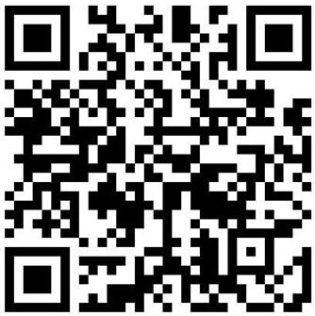
Chaudhary Ahmad Ali
Current working as Chief Architect at iLink Systems
24 plus years of experience in IT
5 years as an SE, 10 years as a DE, and 10 years as a BI Engineer
Recognitions & Certifications
Fast Track Recognized Solution Architect (FTRSA 2022-2023)
TOGAF Certified
PL-300, DP-500, DP-600, DP-700
Favorite Movies
Meet Joe Black, Shawshank Redemption, Forrest Gump, Legends of the Fall
Favorite Sports and Hobbies
Pickleball, Tennis, Billiard, spending time with family, traveling, and food

Slide 5
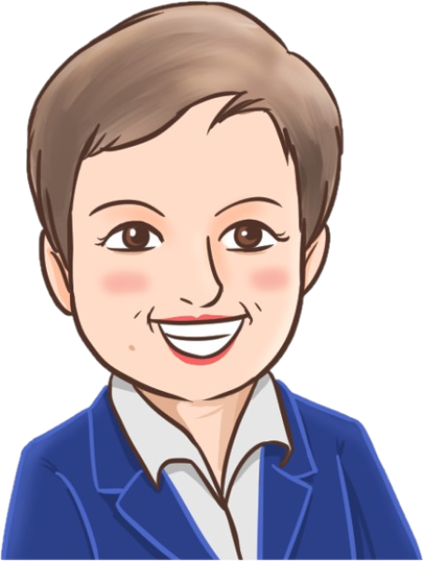
About Belinda Allen - @MsBelindaAllen
Belinda.Allen@iLink-Systems.com
From Alcolu, SC
Microsoft MCT
Co-Authored 2 books
I love learning
I love hobbies
I lived the longest in New York City
Microsoft MVP
Microsoft Partner since 2001
13 years / 5 years GP and 8 years Power BI
13 years (with a hiatus in the middle)
BI and Dynamics GP
Newest hobby: Pickleball
Favorite: Knitting/Crocheting
Technology, Wood Turning, Cooking
In Technology
Started in tech in 1991
Director of Enablement – iLink Digital

Slide 6
Q & A & Thank You

Slide 7
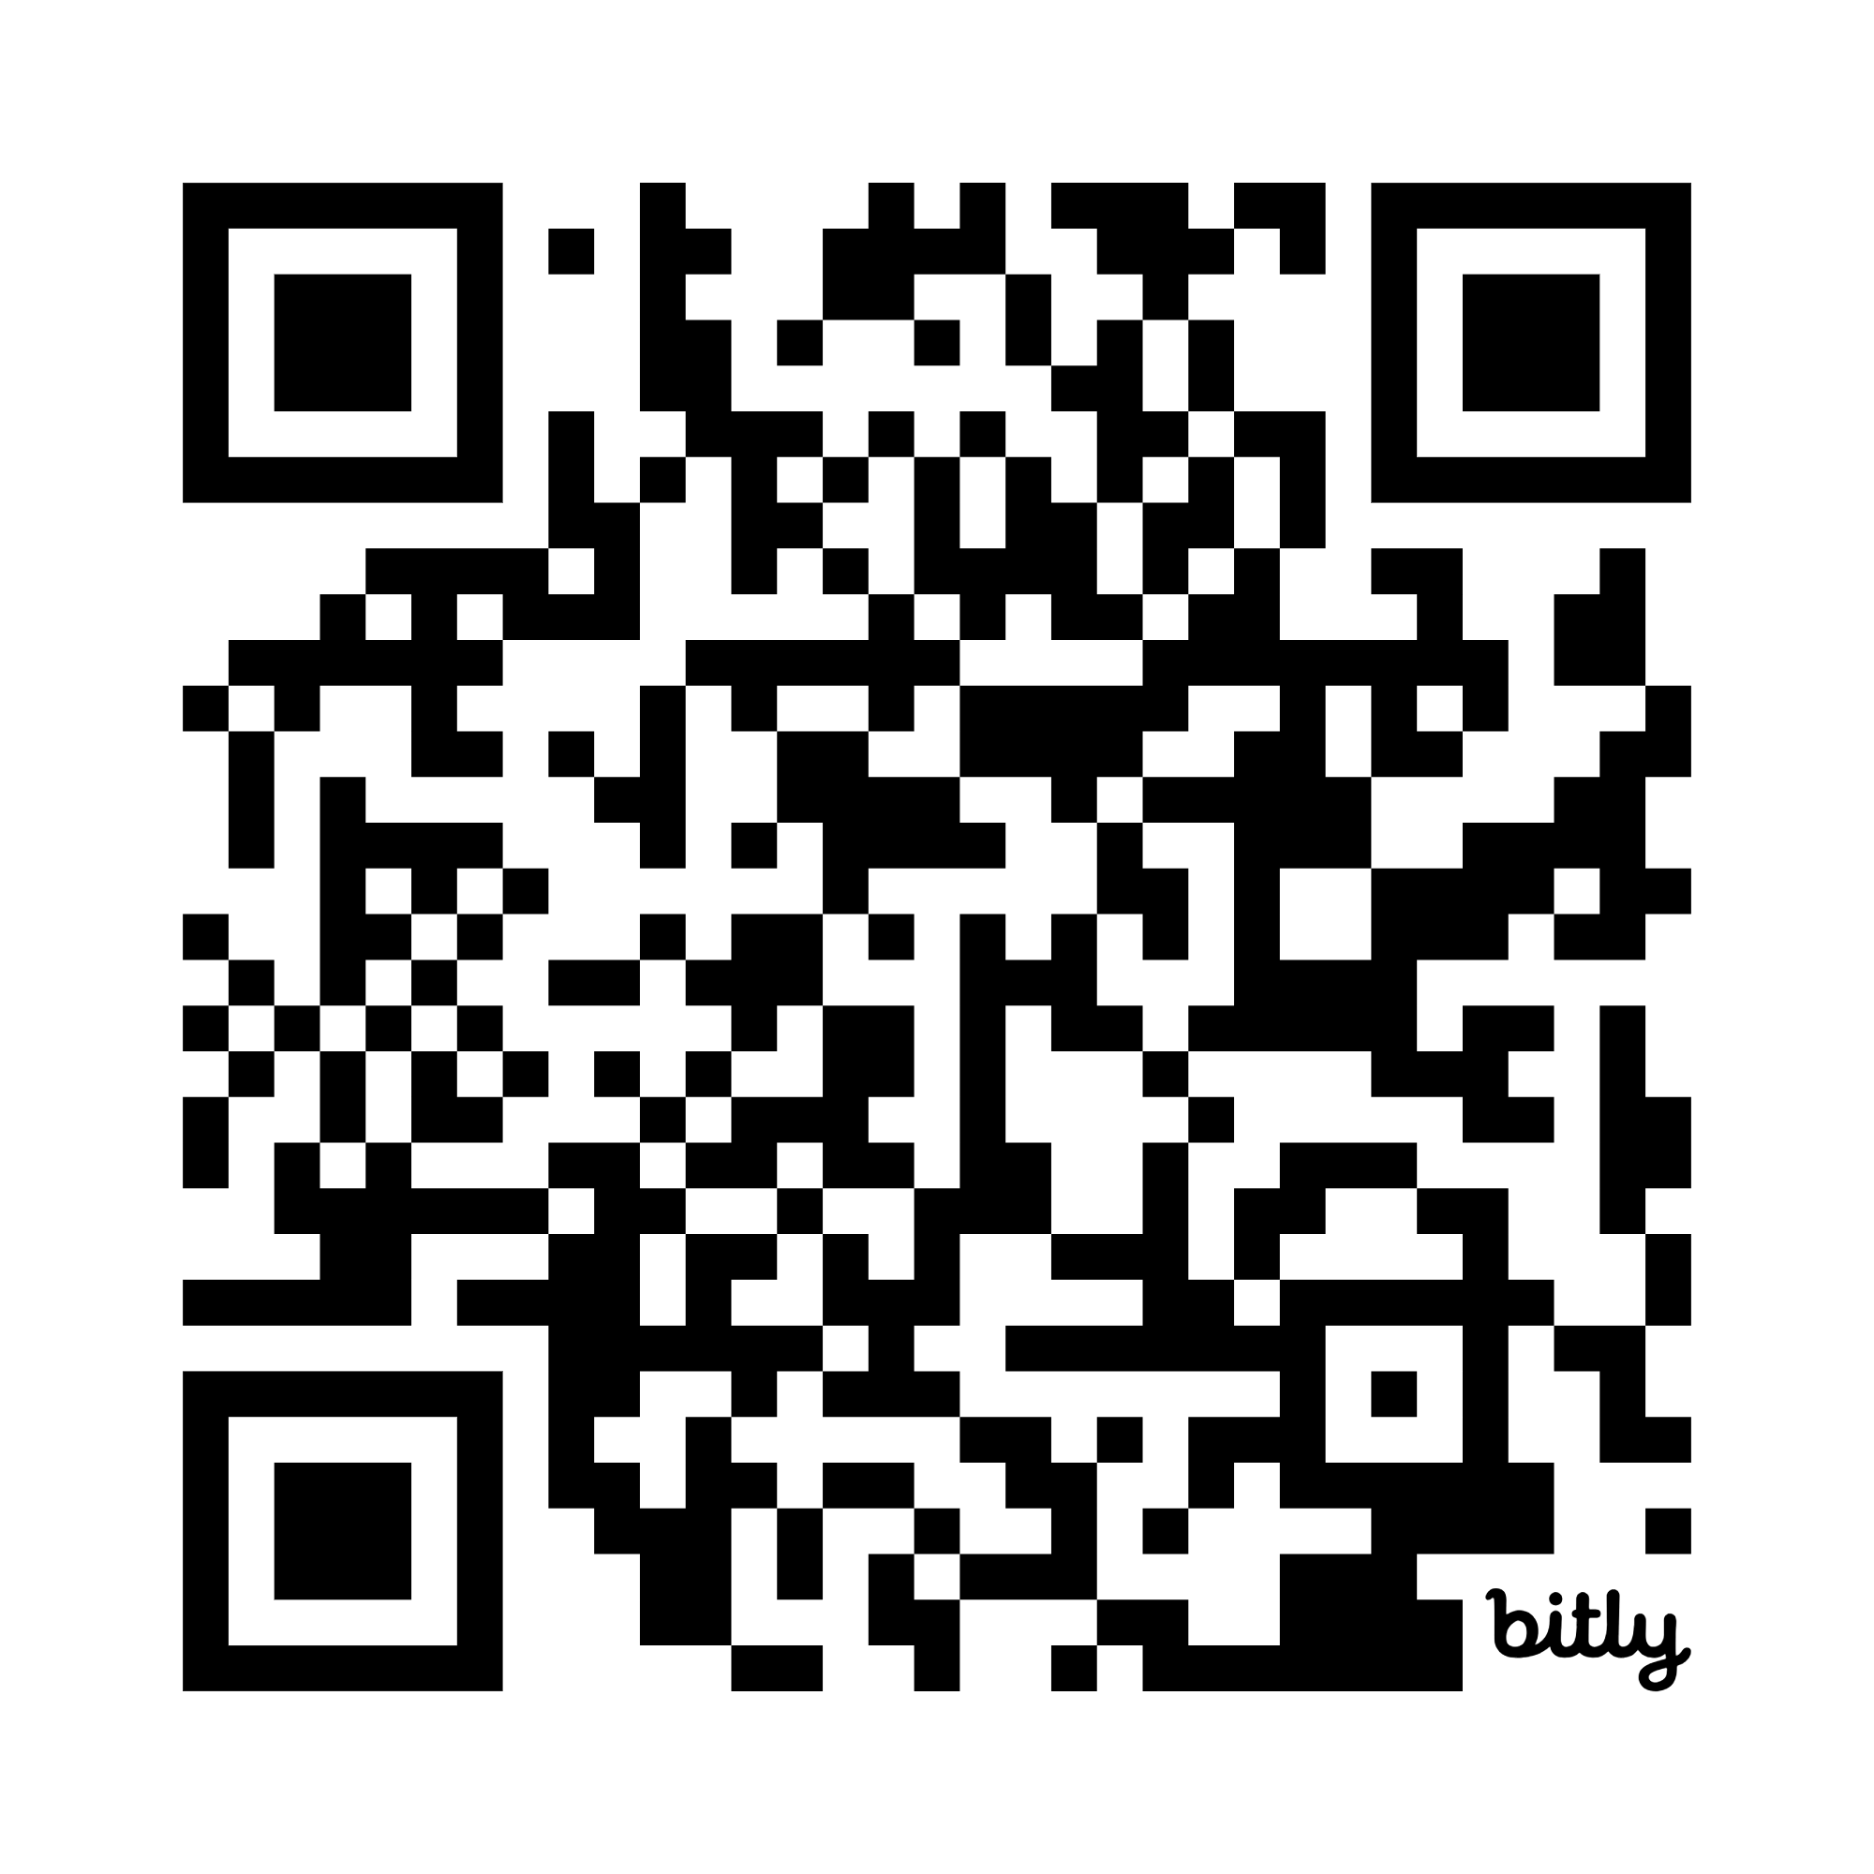
Presentation Link

Slide 8

More Enablement options https://forms.office.com/r/UDRZaBHyz6

